Slide 1
Supporting Documents
For a Job Application

Slide 2
What Are They?
Documents that may be required when applying for a job.
May include:
Cover letter
Resume
Transcript(s)
Portfolios
Certifications
Reference List
Letters of Recommendation

Slide 3
Employment Reference List
Do not include when you submit your resume
Have it ready on a separate page that you can give to employer when they ask for it
Before you include a reference on your list, ask for permission
Include full contact information
Full name
Job title
Company name
Full address
Telephone number
Email address

Slide 4
Requesting Letters of Recommendation
If you are asked for a reference list, expect to have your references checked before getting an offer.
Who to ask:
Someone who knows you and your background well
Should have a good idea what they will say about you
Professors/Academic advisors
Previous employers/supervisors
Business acquaintances
Volunteer contacts

Slide 5
What Will They be Asked?
How will you fit in the position?
Are you dependable?
How do you get along with others?
What are your key strengths?
What areas may require additional work?

Slide 6
Sample Questions Asked?
When did John work for you?
Why did he leave your employ?
What was his position?
What was his starting and ending salary?
Did he miss any work? Was he ever late?
How did he get along with management and fellow workers?
How did he handle conflict? Pressure? Stress?
How would you evaluate his overall performance?
Would you rehire him? Why? Why not?

Slide 7
How to Ask for Recommendation
Do not ask:
“Could you write a letter of reference for me?”
Rather ask:
“Do you feel you know me and my work well enough to write me a good recommendation letter?” or “Do you feel you could give me a good reference?”

Slide 8
Sample Letter
I am writing this reference at the request of John Outasp who is applying for the position of tour guide this summer at Read Outdoor Adventure Odysseys.
I have known John for two years in my capacity as a Professor in the Outdoors Adventure Skills Program at Fleming College. John took a number of courses from me (specify actual course names) and earned superior grades in these classes. Based on John's grades, attendance and class participation, I would rate his academic performance in my class as superior.
John has a number of strengths to offer an employer. John is always interested in supporting others. For example, this year when we worked on a field trip to Haliburton, John was helpful to me in collecting and organizing the equipment required for this trip.
I high highly recommend John Outasp. If his performance in my class is any indication of how he would perform in your position, John will be a positive addition to your organization. If you should ever need any additional information you can feel free to contact me at 555-5555 or by email at email@email.com anytime.

Slide 9
Personal References
Also known as a character reference
Provided by an individual who knows you and can vouch for your character and abilities.
Sometimes provided when you don’t have an extensive work record.
Who can provide:
Neighbours
Professors
Academic Advisors
Volunteer leaders
Coaches

Slide 10
Professional Reference
From an individual who can attest to your:
Skills
Qualification
Abilities
Who can provide:
Managers/supervisors
Colleagues
Business contact
Anyone who can recommend you for employment.

Slide 11
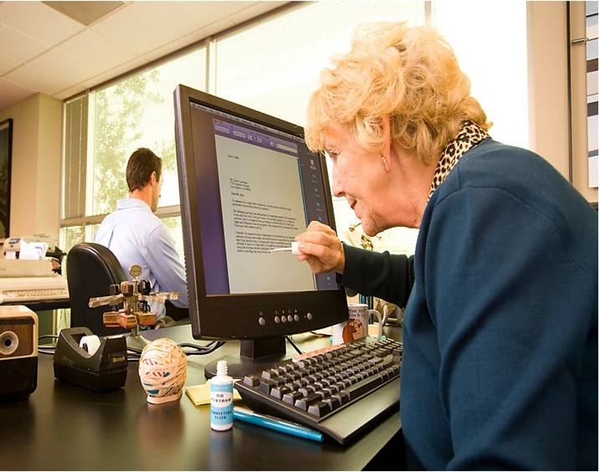
Examples of Documentation
Documentation examples

